Slide 1
Bitcoin: Key-Management, Mining and Attacks

Slide 2
Splitting and Sharing Keys

Slide 3
Secret sharing [Shamir]
(k,n)-secret sharing: Divide a secret value S into n shares S₁,…,S_{n} such that:
Correctness: Any k shares can be used to reconstruct S
Privacy: S is hidden given at most k-1 shares

Slide 4
Secret sharing [Shamir]
Share(S): Output a tuple S₁,…,S_{n}
Reconstruct(x₁,…,x_{k}): Output a value S*
k-Privacy: For any (S,S’), and any subset X of < k indices, the following two distributions are statistically close:

Slide 5
Example: n=2, k=2
p = a large prime
S = secret in [0, P)
R = random in [0, P)
2-Privacy: each x_{i} has uniform distribution over [0,P); independent of S
Share(S):
x₁ = (S+R) mod p x₂ = (S+2R) mod p
Reconstruct(x₁,x₂):
(2x₁-x₂) mod p = S

Slide 6
Example: k = 2, n > 2
k-Privacy: Given only one point, line is undetermined
y
random slope R
(4, S+4R)
(2, S+2R)
(3, S+3R)
given any two points,
can interpolate and find S
(0, S)
(1, S+R)
(do arithmetic modulo large prime p)
x

Slide 7
Going Beyond k = 2
Equation | Random parameters | Points needed to recover S
(S + RX) mod p | R | 2
(S + R₁X + R₂X²) mod p | R₁, R₂ | 3
(S + R₁X + R₂X² + R₃X³) mod p | R₁, R₂, R₃ | 4
etc.
support K-out-of-N sharing, for any K, N

Slide 8
Secret sharing
Good: Store shares separately, adversary must compromise several shares to get the key.
Bad: To sign, need to bring shares together, to first reconstruct the key. Point of vulnerability

Slide 9
Multi-sig
Lets you keep shares apart, approve transaction without reconstructing key at any point.

Slide 10
Example
Alice, Bob, Charlie, and David are co-founders of a company.
Each of the four generates a key-pair, puts secret key in a safe, private, offline place.
The company’s cold-stored coins use multi-sig, so that three of the four keys must sign to release a coin.

Slide 11
Threshold Signatures
(k,n)-Threshold Signatures: A signing key can be “divided” amongst n signers such that any subset of k signers can jointly produce a signature, but any subset of <k signers cannot
TSetup(1^{n}): Each party learns PK. Party i additionally learns Sk_{i}
TSign(m): Parties run a protocol to compute a signature sig on m
TVerify(PK,m,sig): Output 0/1

Slide 12
Threshold Signatures
Advantages over Multi-Sig:
Threshold policy enforced in signature scheme as opposed to script
Threshold signature size can potentially be same as a single signature (as opposed to increasing linearly with k)
Threshold policy can be hidden in Threshold signatures
----

Slide 13
Threshold Signatures
(k,n)-Threshold Signatures for EC-DSA: Many solutions known, see e.g., [Gennaro-Goldefeder-Narayanan’16]
However, all known solutions require interactive signing protocol. Recently, practical schemes constructed
Question: Threshold Signatures with 1-round signing process?

Slide 14
Bitcoin Mining

Slide 15
Mining Bitcoins in 6 easy steps
Join the network, listen for transactions
Validate all proposed transactions
Listen for new blocks, maintain block chain
When a new block is proposed, validate it
Assemble a new valid block
Find the nonce to make your block valid
Hope everybody accepts your new block
Money!
Useful to Bitcoin network
Notes:
Image is public domain (Wikimedia commons)

Slide 16
Finding a valid block
prev: H( )
prev: H( )
mrkl_root: H( )
mrkl_root: H( )
nonce: 0x0000...
nonce: 0x0001...
nonce: 0xf77e...
nonce: 0x0002...
nonce: 0x0000...
nonce: 0xffff...
nonce: 0x7a83
nonce: 0x0001...
hash:
hash: 0x3485...
hash: 0x6a1f...
hash: 0xc9c8...
hash: 0x0000...
hash: 0x300c...
hash: 0xd0c7...
hash:
hash: 0x0000
hash: 0x0224...
All changed
H( ) H( )
H( ) H( )
H( ) H( )
12.5→A
coinbase:
0x0000...01
12.5→A
coinbase:
0x3df5...65
12.5→A
coinbase:
0x0000...00
transaction
transaction
transaction
Notes:
Make sure to point out-coinbase is why miners aren’t all solving the exact same problem

Slide 17
Mining difficulty “target”
0000000000000000003AAEA20000000000000000000000000000000000000000
256 bit hash output
72+ leading zeroes required
2018 difficulty ~ 2⁷²

Slide 18
Setting the mining difficulty
Every two weeks, compute:
next_difficulty = previous_difficulty *
(2 weeks)/(time to mine last 2016 blocks)
Expected number of blocks in 2 weeks at 10 minutes/block

Slide 19
CPU mining (numbers from 2014)
Using a SAT Solver to mine bitcoin
https://jheusser.github.io/2013/02/03/satcoin.html
while (1){
HDR[kNoncePos]++;
IF (SHA256(SHA256(HDR)) < (65535 << 208)/ DIFFICULTY)
return;
}
Throughput on a high-end PC = 10-20 MHz ≈ 2²⁴
139,461 years to find a block!

Slide 20
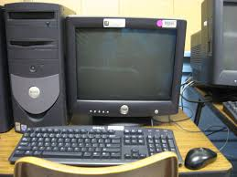
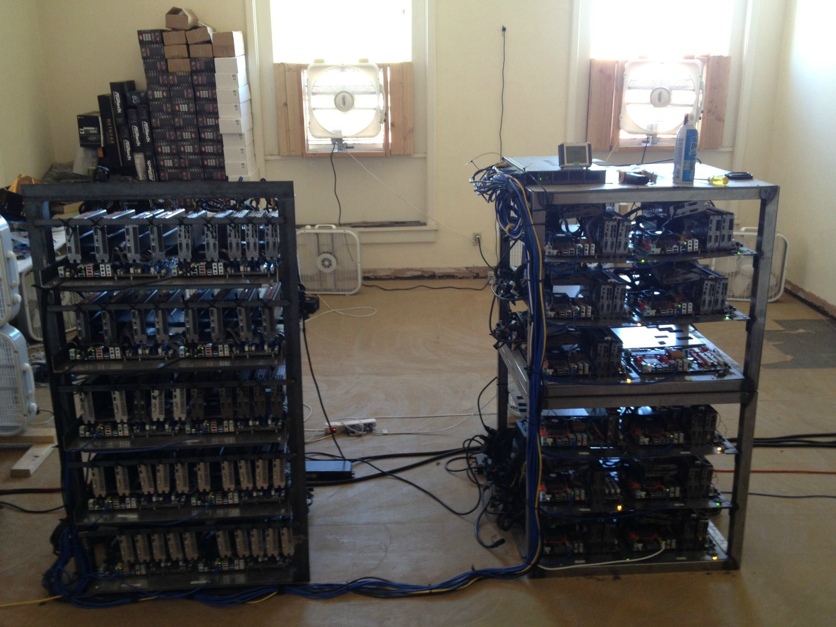
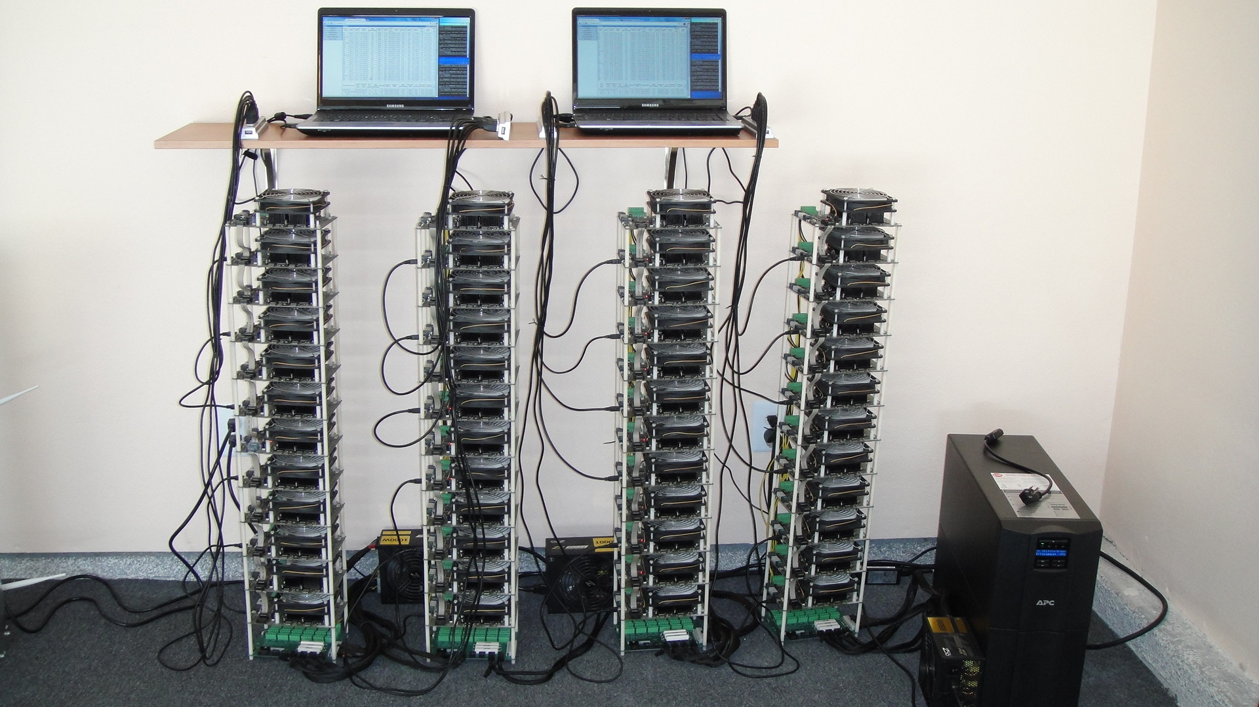
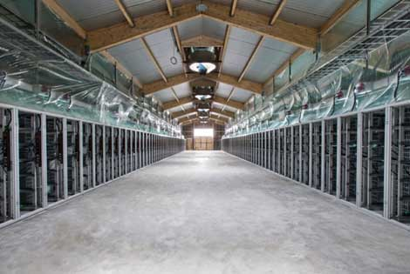
Evolution of mining
CPU GPU FPGA ASIC
Huge energy consumption (in 2017, annual rate nearly as high as Denmark)!

Slide 21
The future
Can small miners stay in the game?
Would we be better off without ASICs?
Should we implement consensus without proofs of work?
Motivation for Altcoins

Slide 22
Mining pools

Slide 23
Economics of being a small miner
In 2014, expected revenue: ≈$1,000/month
High probability (~50%) of not mining a block within a year

Slide 24
Mining pools
Goal: pool participants all attempt to mine a block with the same coinbase recipient
send money to key owned by pool manager
Distribute revenues to members based on how much work they have performed
minus a cut for pool manager
How do we know how much work members perform?

Slide 25
Mining shares
Idea: prove work with “near-valid blocks” (shares)
4AA087F0A52ED2093FA816E53B9B6317F9B8C1227A61F9481AFED67301F2E3FB
D3E51477DCAB108750A5BC9093F6510759CC880BB171A5B77FB4A34ACA27DEDD
00000000008534FF68B98935D090DF5669E3403BD16F1CDFD41CF17D6B474255
BB34ECA3DBB52EFF4B104EBBC0974841EF2F3A59EBBC4474A12F9F595EB81F4B
00000000002F891C1E232F687E41515637F7699EA0F462C2564233FE082BB0AF
0090488133779E7E98177AF1C765CF02D01AB4848DF555533B6C4CFCA201CBA1
460BEFA43B7083E502D36D9D08D64AFB99A100B3B80D4EA4F7B38E18174A0BFB
000000000000000078FB7E1F7E2E4854B8BC71412197EB1448911FA77BAE808A
652F374601D149AC47E01E7776138456181FA4F9D0EEDD8C4FDE3BEF6B1B7ECE
785526402143A291CFD60DA09CC80DD066BC723FD5FD20F9B50D614313529AF3
000000000041EE593434686000AF77F54CDE839A6CE30957B14EDEC10B15C9E5
9C20B06B01A0136F192BD48E0F372A4B9E6BA6ABC36F02FCED22FD9780026A8F

Slide 26
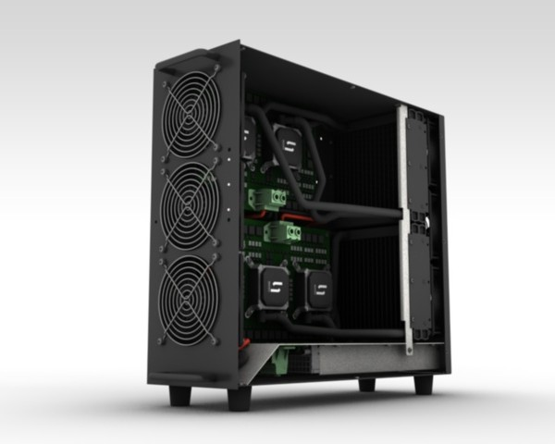
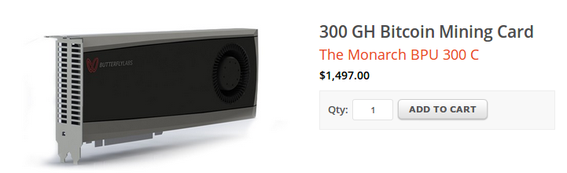
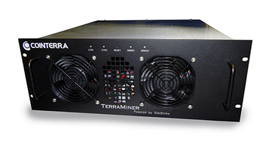
Mining pools
Hey folks! Here’s our next block to work on
Pool manager
prev: H( )
mrkl_root: H( )
coinbase:
12.5→pool
$$$
nonce:
hash:
$$
0x00000000000a877902e...
$
0x000000000001e8709ce...
0x00000000000000003f89...
0x00000000000490c6b00...
0x0000000000007313f89...
0x0000000000045a1611f...

Slide 27
Mining pool history
First pools appear in late-2010
Back in the GPU era!
By 2014: around 90% of mining pool-based
June 2014: GHash.io exceeds 50%

Slide 28
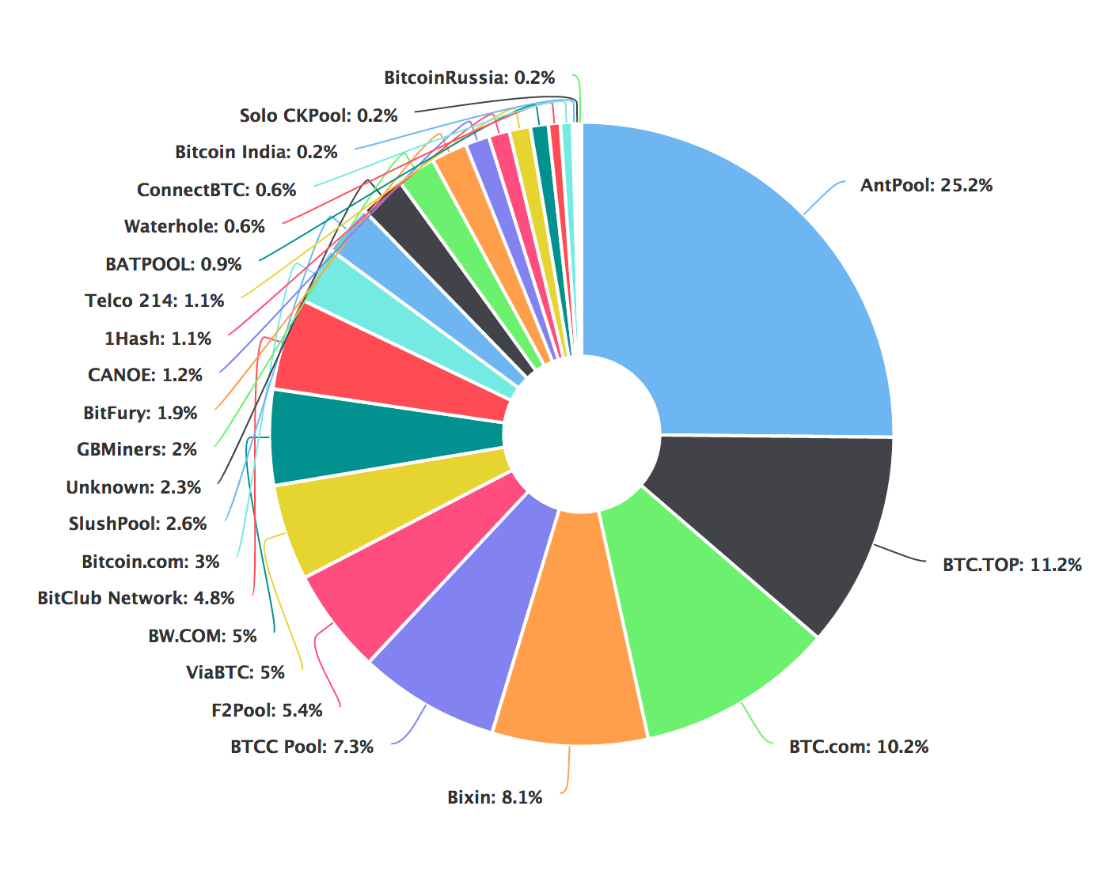
Mining pools

Slide 29
Are mining pools a good thing?
Pros
Make mining more predictable
Allow small miners to participate
More miners using updated validation software
Cons
Lead to centralization
Discourage miners from running full nodes
Question: Can we prevent pools?

Slide 30
Mining incentives and strategies

Slide 31
Game-theoretic analysis of mining
Several strategic decisions
Which transactions to include in a block
Default: any above minimum transaction fee
Which block to mine on top of
Default: longest valid chain
How to choose between colliding blocks
Default: first block heard
When to announce new blocks
Default: immediately after finding them

Slide 32
Game-theoretic analysis of mining
Assume you control 0 < α < 1 of mining power
Can you profit from a non-default strategy?
For some α, YES!

Slide 33
Forking attacks
M→M’
M→M’
M→B
M→B

Slide 34
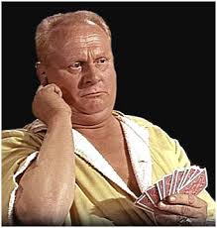
Forking attacks
I expect you to die, Mr. Bitcoin
Certainly possible if α >0.5
may be possible with less
Attack is detectable
Might be reversed
Might crash exchange rate
Goldfinger Attack

Slide 35
Forking attacks via bribery
Idea: building α > 0.5 is expensive. Why not rent it instead?
Payment techniques:
Out-of-band bribery
Run a mining pool at a loss
Insert large “tips” in the block chain

Slide 36
Block-withholding attacks
Strategy: don’t announce blocks right away. Try to get ahead!
“Selfish mining”
Secret Block
Secret Block
All other miners are wasting effort here!

Slide 37

Block-withholding attacks, take 2
What happens if a block is announced when you’re ahead by 1?
Secret Block
The race is on!

Slide 38
Block-withholding attacks
Improved strategy for any α if you can win every race
Ideal network position
Bribery?
With a 50% chance of winning races, improved strategy for α > 0.25
Not yet observed in practice!
Surprising departure from previous assumptions

Slide 39
Selfish-mining attacks
Surprising departure from previous assumptions
Not yet observed in practice!
Plausible reason: selfish-mining is detectable, could lead to a crash in exchange rates for Bitcoin

Slide 40
Punitive forking
Suppose you want to blacklist transactions from address X
Freeze an individual’s money forever
Extreme strategy: announce that you will refuse to mine on any chain with a transaction from X
With α < 0.5, you’ll soon fall behind the network

Slide 41
Feather-forking strategy
To blacklist transactions from X, announce that you will refuse to mine directly on any block with a transaction from X
but you’ll concede after n confirming blocks
Chance of pruning an offending block is α²

Slide 42
Response to feather forking
For other miners, including a transaction from X induces an α² chance of losing a block
Might be safer to join in on the blacklist
Can enforce a blacklist with α < 0.5!
Success depends on convincing other miners you’ll fork

Slide 43
Feather-forking: what is it good for?
Freezing individual bitcoin owners
ransom/extortion
law enforcement?
Enforcing a minimum transaction fee
Current transaction fees are low (about 2% of revenue)
But may become significant when mining reward becomes low

Slide 44
Summary
Miners are free to implement any strategy
Very little non-default behavior in the wild
Game-theoretic analysis necessary
Very recent work: [Badertscher-Garay-Maurer-Tshudi-Zikas, EUROCRYPT’18]

